Slide 1
Asymptotic Analysis of Algorithms

Slide 2
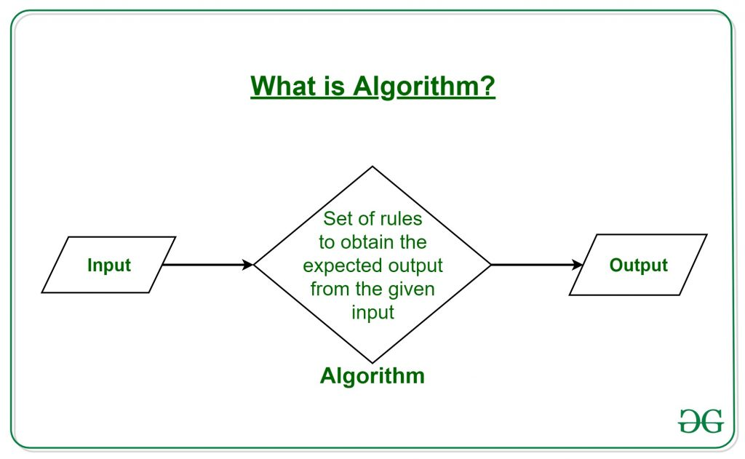
What is Algorithm?
A procedure for solving a mathematical problem in a finite number of steps

Slide 3
Types of Algorithms:
Brute Force Algorithm
Recursive Algorithm
Backtracking Algorithm
Searching Algorithm
Sorting Algorithm
Hashing Algorithm
Divide and Conquer Algorithm
Greedy Algorithm
Dynamic Programming Algorithm
Randomized Algorithm

Slide 4
Asymptotic Notations
In mathematics, asymptotic analysis, also known as asymptotics, is a method of describing the limiting behavior of a function.
Asymptotic analysis of an algorithm refers to defining the mathematical boundation of its run-time performance based on the input size
f(n) = c: This means the running time will be independent of the input size
f(n) = n : This means the running time will increase linearly with the increase in n.

Slide 5
Analysis of an algorithm is done based on three cases:
Best Case (Omega Notation (Ω))
Average Case (Theta Notation (Θ))
Worst Case (O Notation(O))

Slide 6
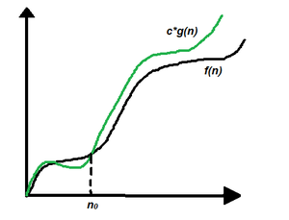
Big-O Notation(Upper Bound)
f(n) = O(g(n)), If there are positive constants n0 and c such that, to the right of n0 the f(n) always lies on or below c*g(n).
f(n) <= c*(g(n))

Slide 7
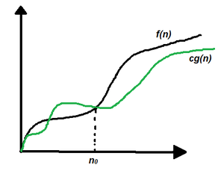
Omega Notation(Lower Bound)
f(n) = Ω(g(n)), If there are positive constants n0 and c such that, to the right of n0 the f(n) always lies on or above c*g(n).
f(n) >= (g(n))

Slide 8
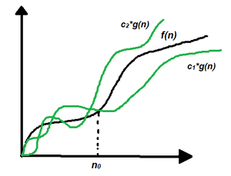
Theta Notation
f(n) = Θ(g(n)), If there are positive constants n0 and c such that, to the right of n0 the f(n) always lies on or above c1*g(n) and below c2*g(n)
c1*g(n) <= f(n) <= c2*g(n)

Slide 9
Little-o(Loose upper bound)
f(n) = o(g(n)), If there are positive constants n0 and c such that, to the right of n0 the f(n) always lies below c*g(n).
f(n) < c*(g(n))

Slide 10
little-omega:(Loose Lower Bound)
f(n) = ω(g(n)), If there are positive constants n0 and c such that, to the right of n0 the f(n) always lies above c*g(n).
f(n) > (g(n))

Slide 11
What does ‘Space Complexity’ mean?
Auxiliary Space is the extra space or temporary space used by an algorithm
The space Complexity of an algorithm is the total space taken by the algorithm with respect to the input size
Space complexity includes both Auxiliary space and space used by input.

Slide 12
Gate Questions
https://practicepaper.in/gate-cse/asymptotic-notation

